Slide 1
Dimensionality Reduction
Implementation examples : https://github.com/peeyushsinghal/dimensionality_reduction

Slide 2
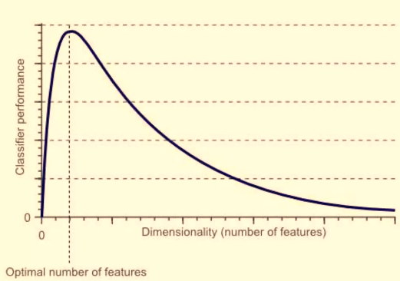
Outline – Dimensionality Reduction
Motivation
Matrices are sometimes redundant or rather computationally expensive. We may want to compress data
Need for data visualization – cannot visualize n-Dimension data (n >3)
Untangle information – not bogged down by too much information. Reduces cost of further experimentation etc.
Curse of Dimensionality
Recap: Covariance, Eigen values, Eigen vectors and Eigen decomposition
Singular Value Decomposition
Derivation
Need
Implementation example
Principal Component Analysis
Introduction, working
Interpretation
Implementation example
Latent Discriminant Analysis
Introduction, working
Derivation
Implementation example
Manifold Learning : Introduction
t-SNE
Introduction
Process
Objective Function
Implementation Example

Slide 3
Dimensionality Reduction – Focus on extraction rather than selection
Feature Extraction
Feature
Selection
Component / Factor based
PCA | SVD…
Projection Based
t-SNE | UMAP | MDS…
Dimensionality Reduction (Feature Treatment)
Feature Elimination
Recursive Feature Elimination | Filters
Supervised
Unsupervised
LDA
When to use Feature Extraction – answer to all the questions is yes:
Do you want to reduce the number of variables, but aren’t able to identify variables to completely remove from consideration?
Do you want to ensure your variables are independent of one another?
Are you comfortable making your independent variables less interpretable?
Primarily used for unsupervised learning
Generic settings – visualization etc.
Method largely independent on the dependent variable

Slide 4
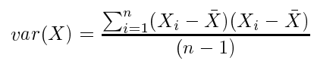
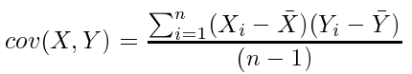
Recap: Variance, Covariance, Correlation
Variance and Covariance:
Measure of the “spread” of a set of points around their center of mass(mean)
Variance:
Measure of the deviation from the mean for points in one dimension
Covariance:
Measure of how much each of the dimensions vary from the mean with respect to each other
Correlation:
Measures of how much each of the dimensions vary from the mean with respect to each other, also includes a band [-1,1]
Covariance is measured between two dimensions
Covariance sees if there is a relation between two dimensions
Covariance between one dimension is the variance

Slide 5
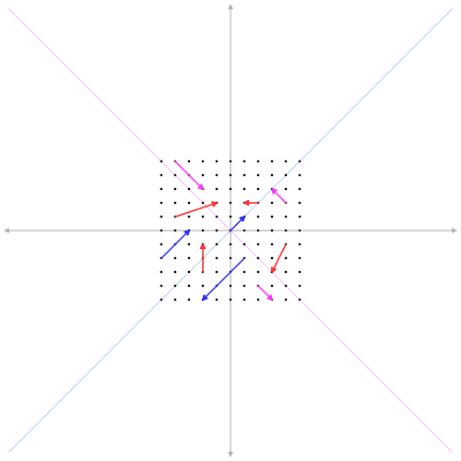
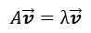
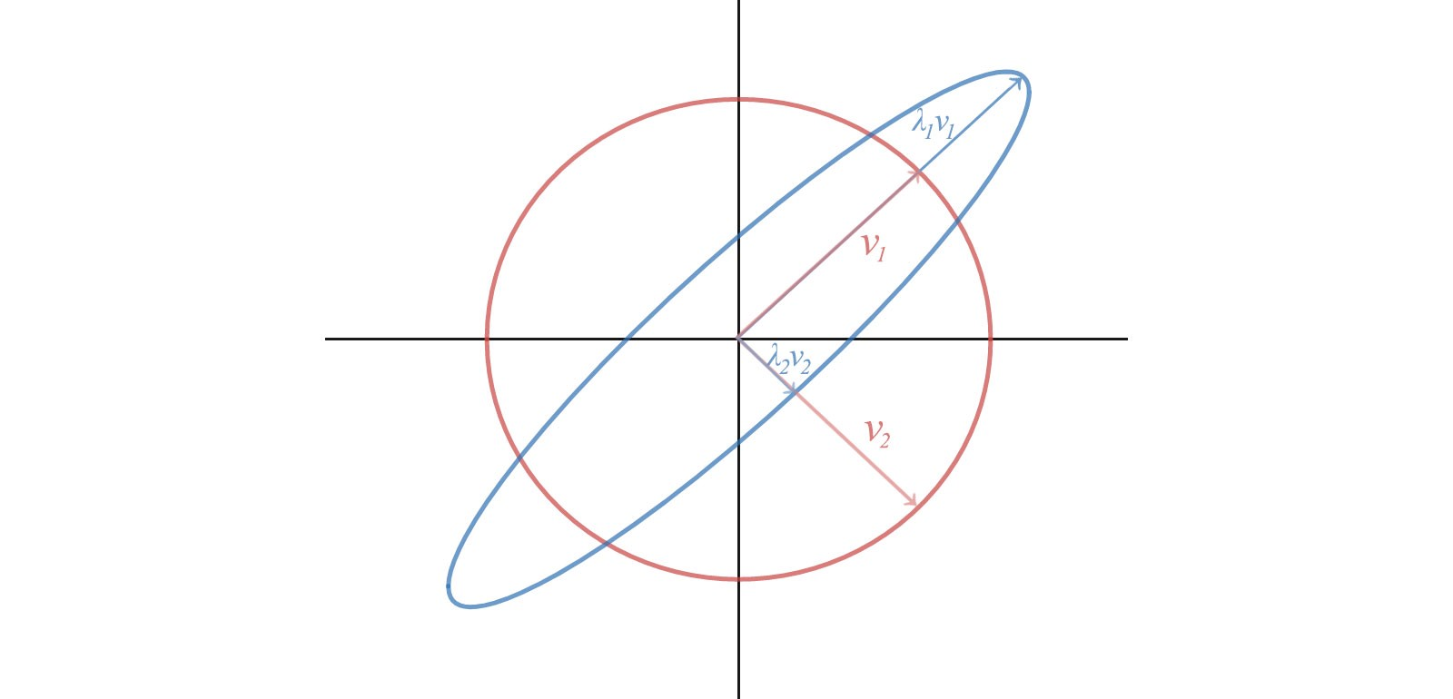
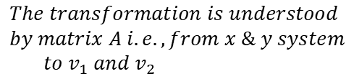
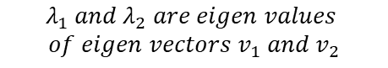
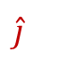
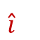
Recap: eigen vectors and values
Eigen Value, Scalar:
The value by which the eigen vector is scaled
Transformation Matrix
One can visualize as where and lie after transformation. Basis vector transformation
Eigen Vector:
Does not change direction after transformation, and therefore it is just scaled in transformation
$$\hat{i}$$
$$\hat{j}$$
$$λ_{1} and{ λ}_{2} are eigen values$$
$$of eigen vectors{ v}_{1} and{ v}_{2}$$
Eigen vectors are vectors which do not change direction after transformations (i.e., multiplication by a matrix). See the blue ones in above picture
Eigen values are values by which the vectors are scaled (extended or squished), negative eigen values means opposition direction to original vector
$$The transformation is understood$$
$$by matrix A i.e., from x \& y system$$
$$to{ v}_{1} and{ v}_{2}$$
Please note that Transformation matrix here is square – 2 basis vector in 2 dimension, 3 basis vector in 3 dimension etc.
Image Source: https://commons.wikimedia.org/wiki/File:Eigenvectors.gif

Slide 6
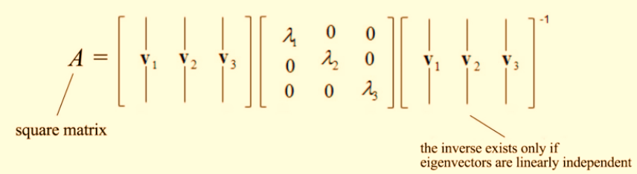
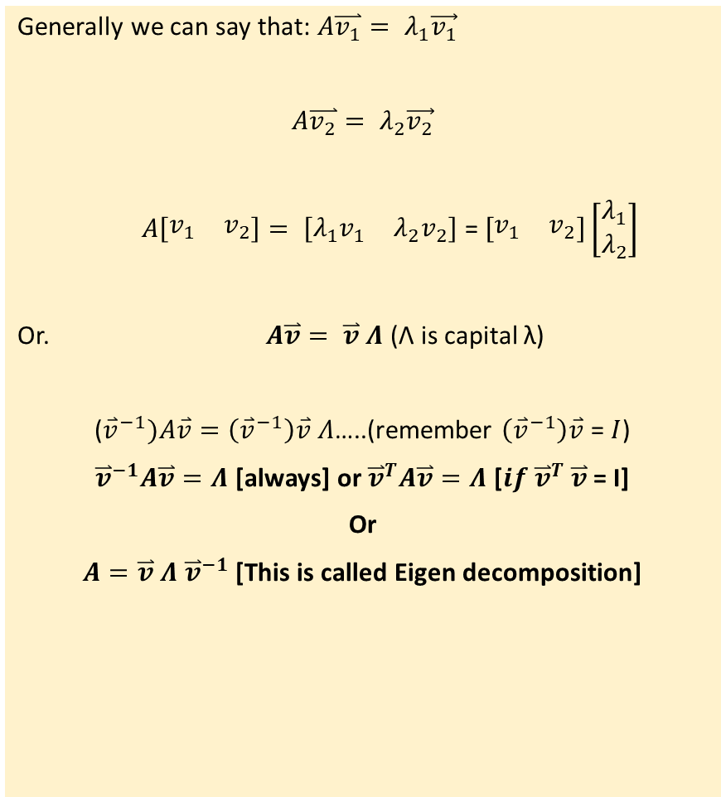
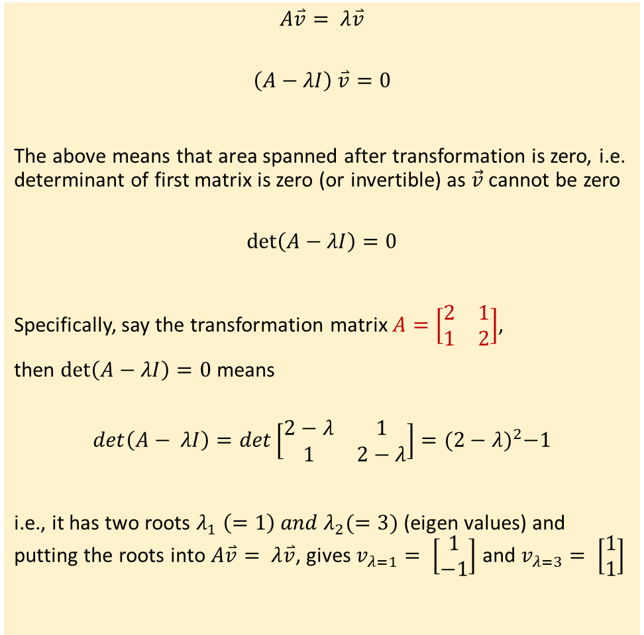
Eigen decomposition
$$A\overset{⃑}{v}= λ\overset{⃑}{v}$$
$$\left(A−λI\right) \overset{⃑}{v}=0$$
The above means that area spanned after transformation is zero, i.e. determinant of first matrix is zero (or invertible) as $\vec{v}$ cannot be zero
$$det\left(A−λI\right)=0$$
Specifically, say the transformation matrix $A=\left[\begin{matrix}2 & 1 \\ 1 & 2\end{matrix}\right]$,
then $det\left(A−λI\right)=0$ means
$$det\left(A− λI\right)=det\left[\begin{matrix}2−λ & 1 \\ 1 & 2−λ\end{matrix}\right]={(2−λ)}^{2}−1$$
i.e., it has two roots $λ_{1} \left(=1\right) and λ_{2}(=3)$ (eigen values) and putting the roots into $A\overset{⃑}{v}= λ\overset{⃑}{v}$, gives $v_{λ=1}= \left[\begin{matrix}1 \\ −1\end{matrix}\right]$ and $v_{λ=3}= \left[\begin{matrix}1 \\ 1\end{matrix}\right]$
Generally we can say that: $A\overset{⃑}{v_{1}}= λ_{1}\vec{v_{1}}$
$A\overset{⃑}{v_{2}}= λ_{2}\vec{v_{2}}$
$A\left[\begin{matrix}v_{1} & v_{2}\end{matrix}\right]= \left[\begin{matrix}λ_{1}v_{1} & λ_{2}v_{2}\end{matrix}\right]$ = $\left[\begin{matrix}v_{1} & v_{2}\end{matrix}\right]\left[\begin{matrix}λ_{1} \\ λ_{2}\end{matrix}\right]$
Or. $A\overset{⃑}{v}= \overset{⃑}{v} Λ$ (Λ is capital λ)
(${\overset{⃑}{v}}^{−1})A\overset{⃑}{v}=\left({\overset{⃑}{v}}^{−1}\right)\overset{⃑}{v} Λ$…..(remember $\left({\overset{⃑}{v}}^{−1}\right)\overset{⃑}{v}$= $I$)
${\overset{⃑}{v}}^{−1}A\overset{⃑}{v}=Λ$ [always] or ${\overset{⃑}{v}}^{T}A\overset{⃑}{v}=Λ$ [${if \overset{⃑}{v}}^{T}$ $\overset{⃑}{v}$= I]
Or
$A=\overset{⃑}{v} Λ$ ${\overset{⃑}{v}}^{−1}$ [This is called Eigen decomposition]
Transformation Matrix for this equation
Transformation Matrix for this equation

Slide 7
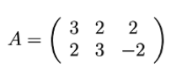
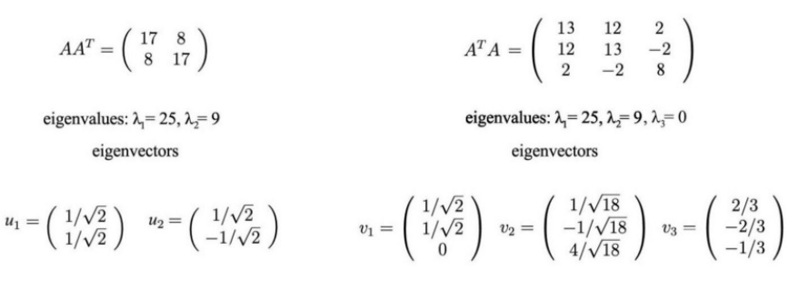
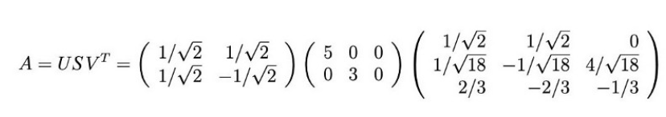
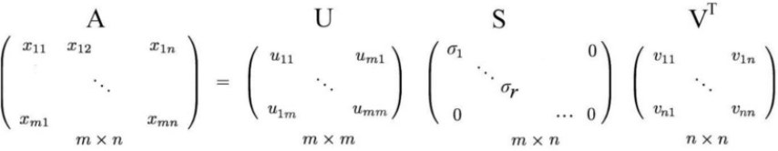
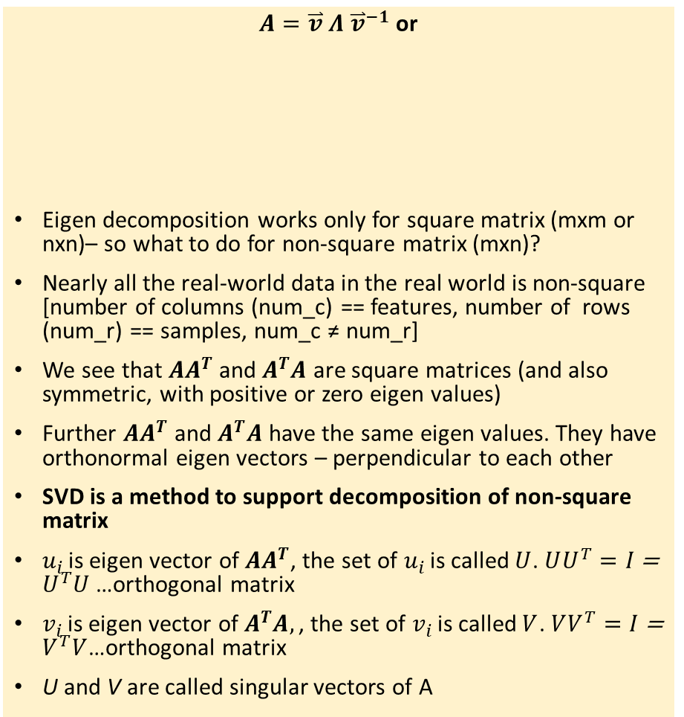
Singular Value Decomposition : A = USV^{T} : What is SVD?
$A=\overset{⃑}{v} Λ$ ${\overset{⃑}{v}}^{−1}$ or
Eigen decomposition works only for square matrix (mxm or nxn)– so what to do for non-square matrix (mxn)?
Nearly all the real-world data in the real world is non-square [number of columns (num_c) == features, number of rows (num_r) == samples, num_c ≠ num_r]
We see that $AA^{T}$ and $A^{T}A$ are square matrices (and also symmetric, with positive or zero eigen values)
Further $AA^{T}$ and $A^{T}A$ have the same eigen values. They have orthonormal eigen vectors – perpendicular to each other
SVD is a method to support decomposition of non-square matrix
$u_{i }$is eigen vector of $AA^{T}$, the set of $u_{i }$is called $U$. $UU^{T}=I$ = $U^{T}U$ …orthogonal matrix
$v_{i }$is eigen vector of $A^{T}A,\text{, }\text{the} \text{set} \text{of} v_{i }\text{is} \text{called} V$. $VV^{T}=I$ = $V^{T}V$…orthogonal matrix
U and V are called singular vectors of A
Special Matrix properties : https://jonathan-hui.medium.com/machine-learning-linear-algebra-special-matrices-c750cd742dfe

Slide 8
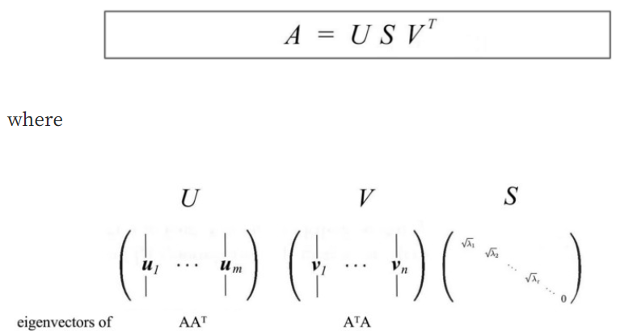
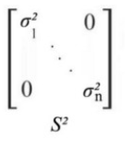
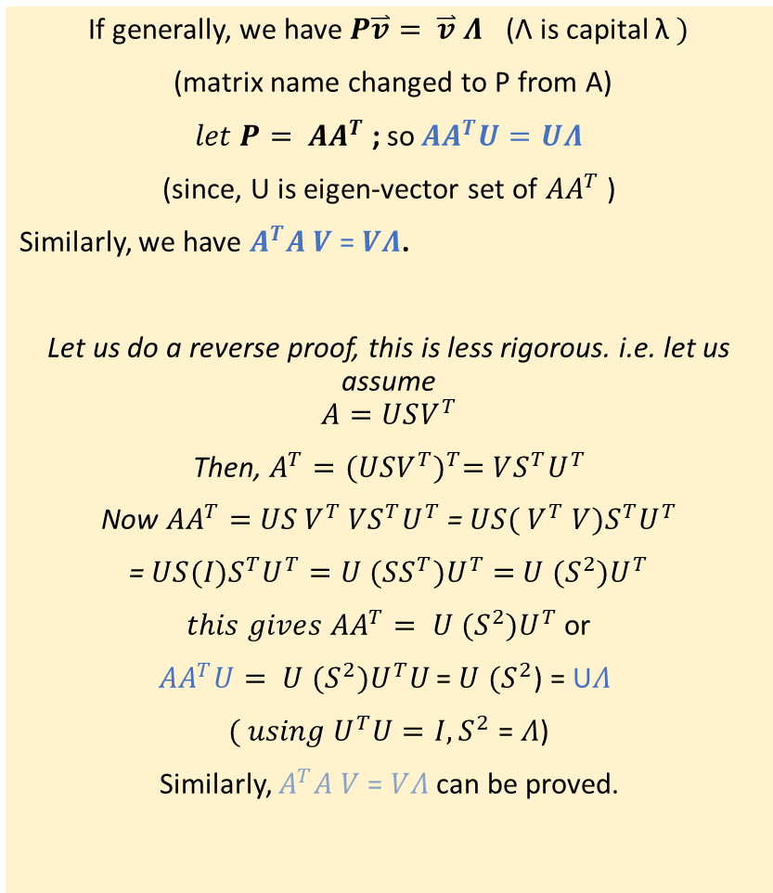
Singular Value Decomposition : A = USV^{T} : How it is derived?
If generally, we have $P\overset{⃑}{v}= \overset{⃑}{v} Λ$ (Λ is capital λ $)$
(matrix name changed to P from A)
$let P= AA^{T}$ ; so$AA^{T}U=UΛ$
(since, U is eigen-vector set of $AA^{T}$ )
Similarly, we have $A^{T}A V$= $VΛ$.
Let us do a reverse proof, this is less rigorous. i.e. let us assume
$$A=USV^{T}$$
Then, $A^{T}={(USV^{T})}^{T}=VS^{T}U^{T}$
Now ${AA}^{T}=$ $US{ V}^{T}$ $VS^{T}U^{T}$ = $US{( V}^{T}$ $V{)S}^{T}U^{T}$
= $US(I{)S}^{T}U^{T}=U$ $(SS^{T}{)U}^{T}=$ $U$ $(S^{2}{)U}^{T}$
${this gives AA}^{T}= U$ $(S^{2}{)U}^{T}$ or
${AA}^{T}U= U$ $(S^{2}{)U}^{T}U$ = $U$ $(S^{2}$) = U$Λ$
$( using U^{T}U=I, S^{2}$ = $Λ$)
Similarly, $A^{T}A V$= $VΛ$ can be proved.
Special Matrix properties : https://jonathan-hui.medium.com/machine-learning-linear-algebra-special-matrices-c750cd742dfe

Slide 9
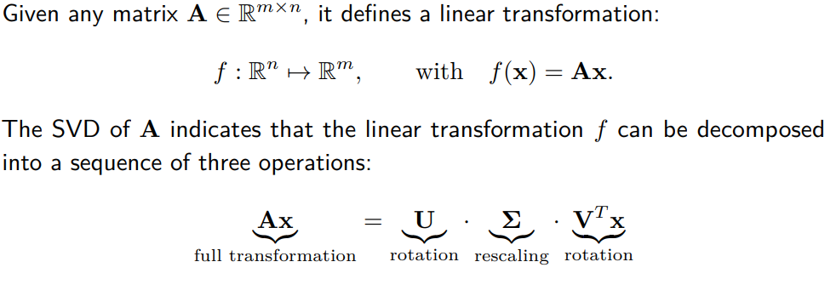
SVD : Geometric interpretation

Slide 10
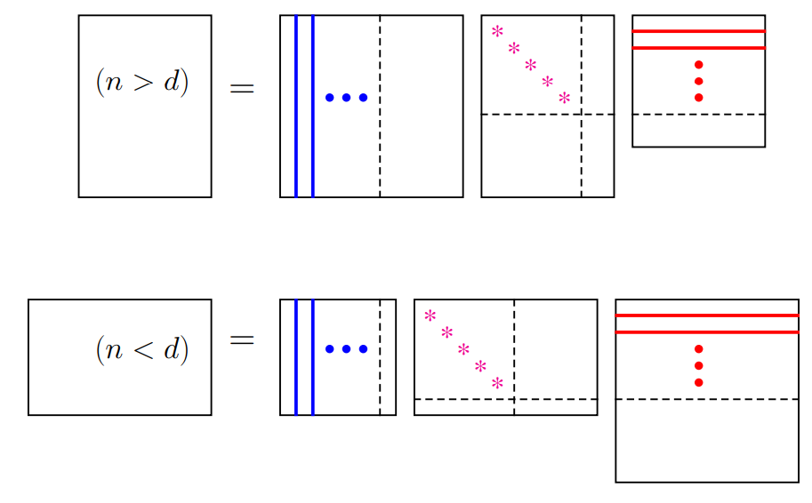
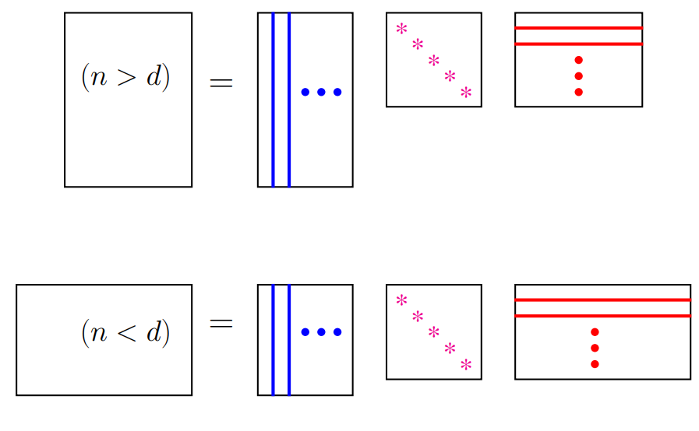
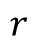
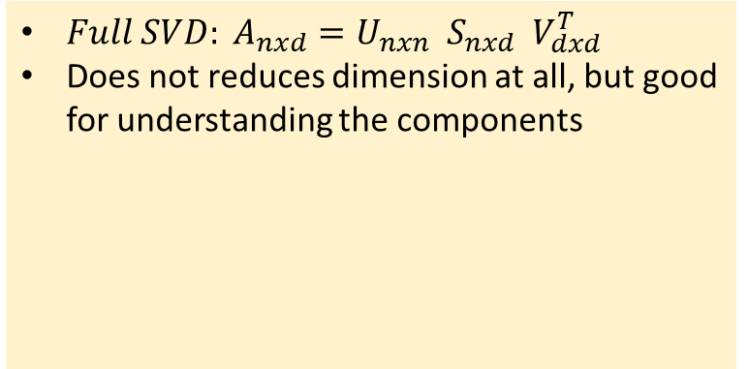
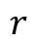
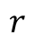
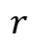
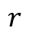
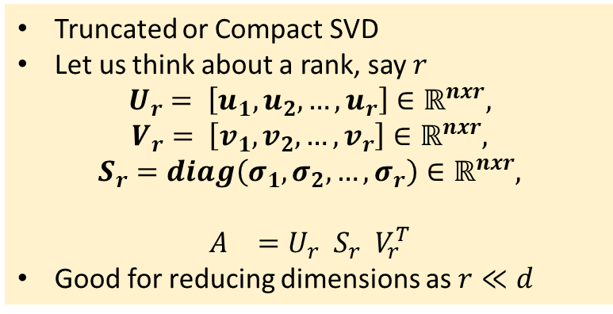
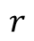
SVD – How we can use it?
${Full SVD: A}_{nxd}=U_{nxn}{ S}_{nxd}{ V}_{dxd}^{T}$
Does not reduces dimension at all, but good for understanding the components
Truncated or Compact SVD
Let us think about a rank, say $r$
$$U_{r}= \left[u_{1},u_{2},…,u_{r}\right]∈ℝ^{nxr},$$
$$V_{r}= \left[v_{1},v_{2},…,v_{r}\right]∈ℝ^{nxr},$$
$$S_{r}=diag\left(σ_{1},σ_{2},…,σ_{r}\right)∈ℝ^{nxr},$$
$$A_{}=U_{r}{ S}_{r}{ V}_{r}^{T}$$
Good for reducing dimensions as $r≪d$
$$r$$
$$r$$
$$r$$
$$r$$
$$r$$
$$r$$

Slide 11
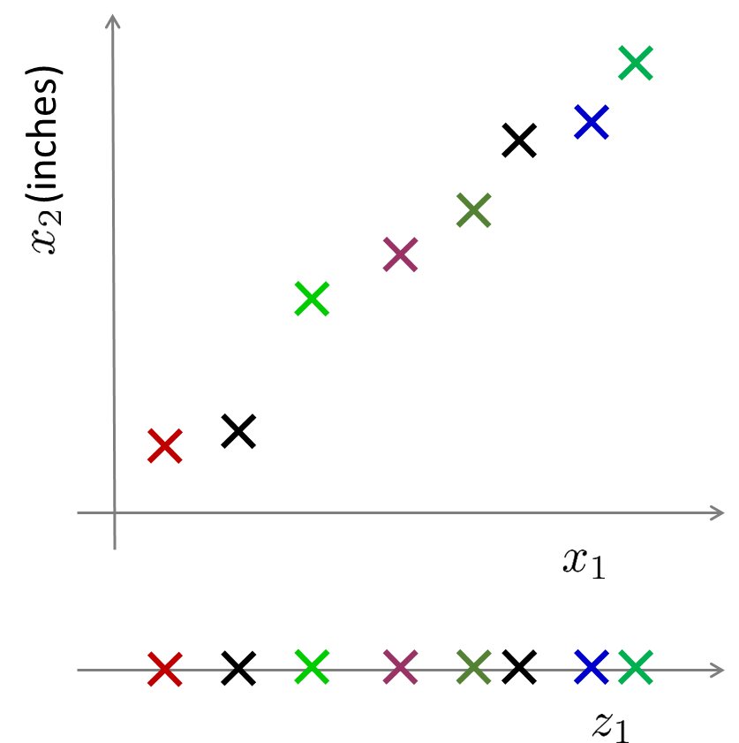
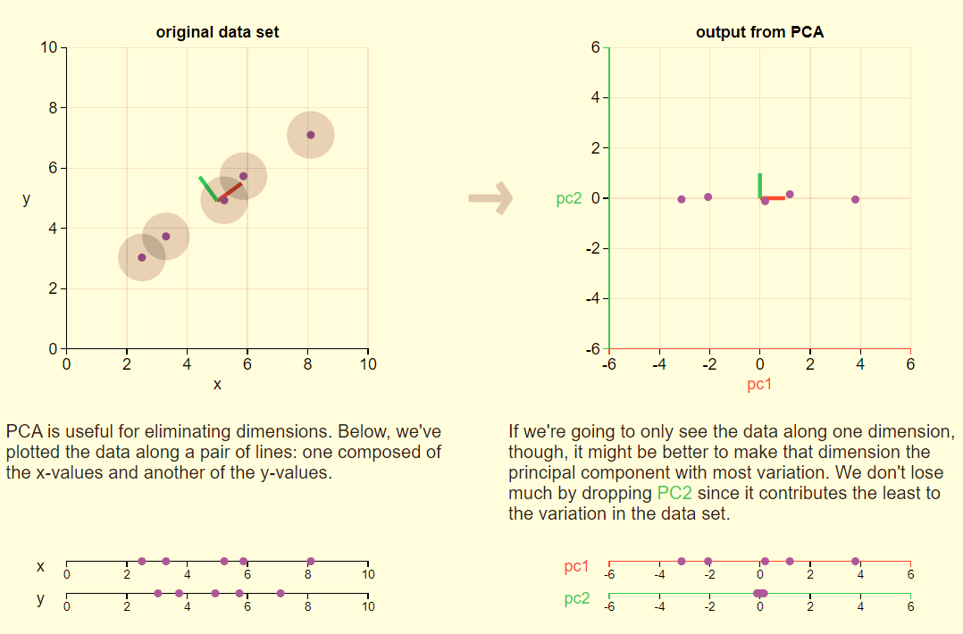
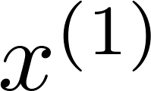
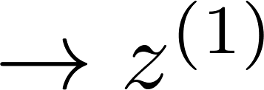
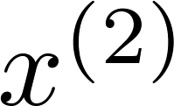
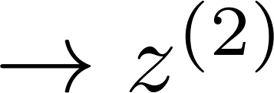
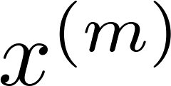
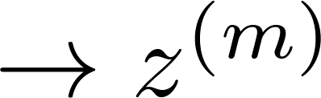
Principal Component Analysis (PCA) - Introduction
Aim to simplify | understand “independent” features / factors | explain the variability of data with less number of features.
Reduce data from 2D to 1D
https://setosa.io/ev/principal-component-analysis/

Slide 12
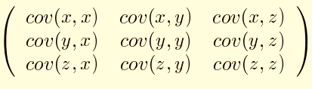
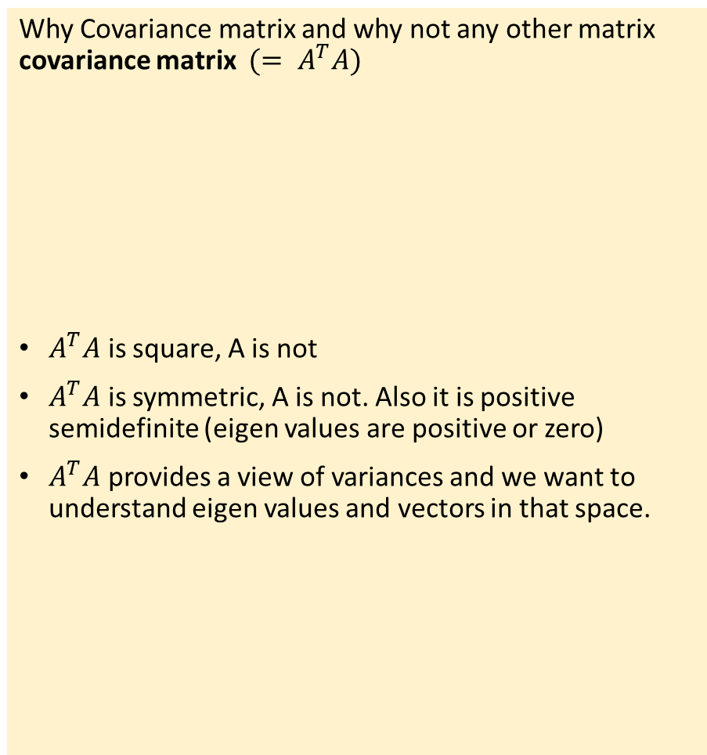
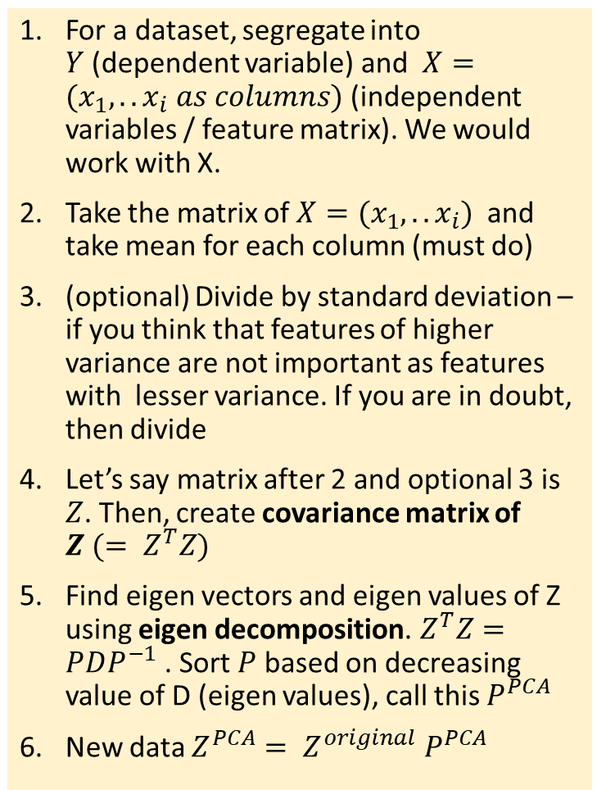
PCA - Process
For a dataset, segregate into $Y$(dependent variable) and $X=(x_{1},..x_{i} as columns)$ (independent variables / feature matrix). We would work with X.
Take the matrix of $X=(x_{1},..x_{i})$ and take mean for each column (must do)
(optional) Divide by standard deviation – if you think that features of higher variance are not important as features with lesser variance. If you are in doubt, then divide
Let’s say matrix after 2 and optional 3 is $Z$. Then, create covariance matrix of $Z (= Z^{T}Z)$
Find eigen vectors and eigen values of Z using eigen decomposition.${ Z}^{T}Z=PDP^{−1}$ . Sort $P$ based on decreasing value of D (eigen values), call this $P^{PCA}$
New data $Z^{PCA}= Z^{original} P^{PCA}$
Why Covariance matrix and why not any other matrix covariance matrix $(= A^{T}A)$
$A^{T}A$ is square, A is not
$A^{T}A$ is symmetric, A is not. Also it is positive semidefinite (eigen values are positive or zero)
$A^{T}A$ provides a view of variances and we want to understand eigen values and vectors in that space.

Slide 13
PCA Interpretation
Principle
Linear projection method to reduce the number of parameters
Transfer a set of correlated variables into a new set of uncorrelated variables
Map the data into a space of lower dimensionality
Form of unsupervised learning
Properties
It can be viewed as a rotation of the existing axes to new positions in the space defined by original variables
New axes are orthogonal and represent the directions with maximum variability
Can ignore the components of lesser significance.
You do lose some information, but if the eigenvalues are small, you don’t lose much
n dimensions in original data
calculate n eigenvectors and eigenvalues
choose only the first p eigenvectors, based on their eigenvalues
final data set has only p dimensions

Slide 14
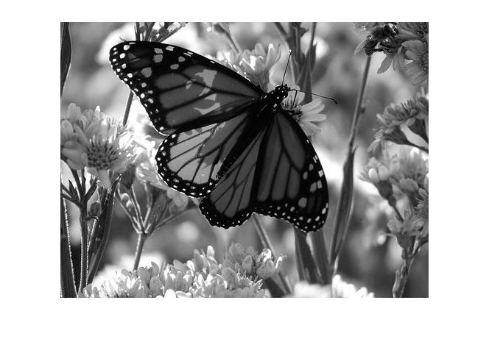
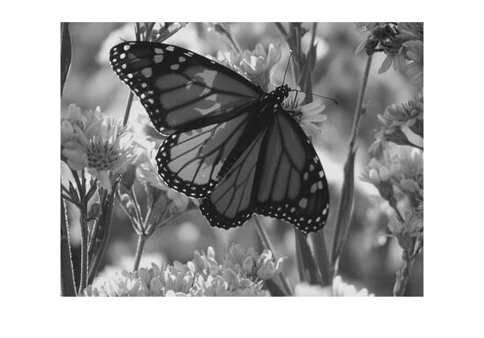
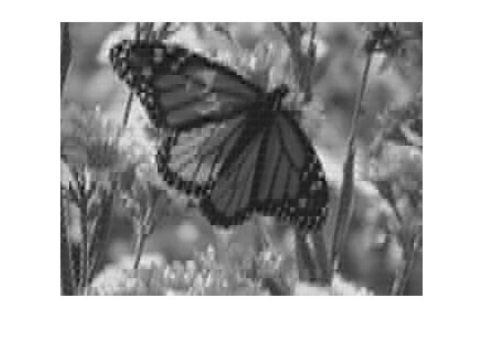

PCA – Usage : Compression, Visualization
Dimensions = 144
Dimensions = 60
Dimensions = 6
Dimensions = 3

Slide 15
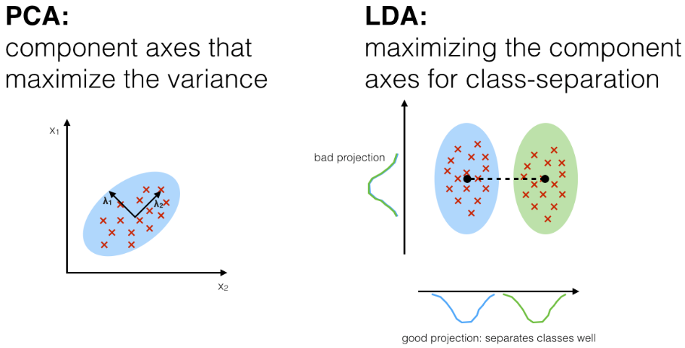
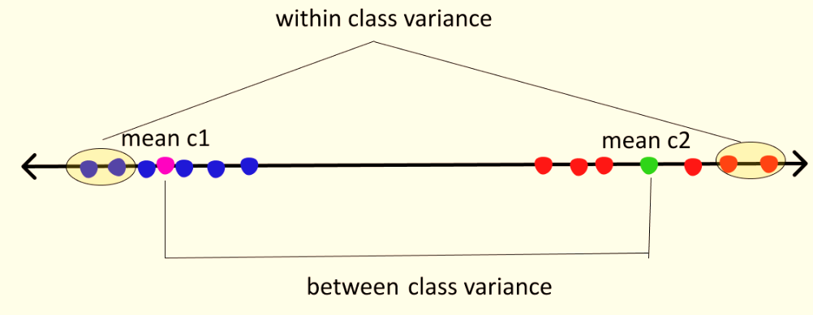
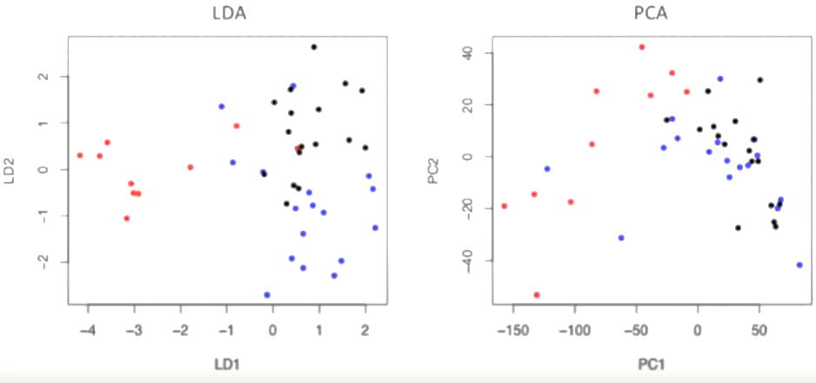
Latent Discriminant Analysis (LDA) – Introduction, difference from PCA
linear model for classification and dimensionality reduction
It requires class assignment of examples – not fully unsupervised algorithm. Typically used for separating n classes (n>2)
LDA projects data from a D dimensional feature space down to a D’ (D>D’) dimensional space in a way to maximize the variability between the classes and reducing the variability within the classes. The variability is called scatter.
Its differs from PCA in that LDA focus on class separation, while PCA focus on capturing maximum variability in data
Both rank the new axes in order of importance
https://sebastianraschka.com/Articles/2014_python_lda.html

Slide 16
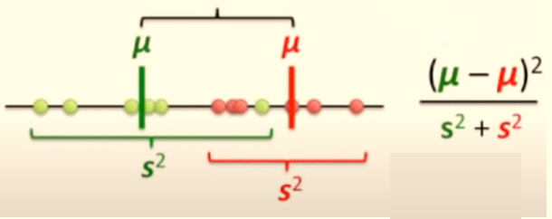


LDA – how does it work?
arg max J(W) = (M₁ – M₂)² / S₁² + S₂²
M₁ and M₂ are means of classes and S₁ and S₂ are class scatter.. The numerator here is between class scatter while the denominator is within-class scatter. So to maximize the function we need to maximize the numerator and minimize the denominator (TOGETHER)
Methodology
2 Dimension example
3 Dimension example
StatQuest (Youtube): Linear Discriminant Analysis (LDA) clearly explained.

Slide 17

LDA – How it is derived?
http://www.facweb.iitkgp.ac.in/~sudeshna/courses/ml08/lda.pdf

Slide 18

LDA – How it is derived?
http://www.facweb.iitkgp.ac.in/~sudeshna/courses/ml08/lda.pdf

Slide 19

LDA – How it is derived?
http://www.facweb.iitkgp.ac.in/~sudeshna/courses/ml08/lda.pdf

Slide 20

LDA – How it is derived?
http://www.facweb.iitkgp.ac.in/~sudeshna/courses/ml08/lda.pdf

Slide 21

LDA – How it is derived?
http://www.facweb.iitkgp.ac.in/~sudeshna/courses/ml08/lda.pdf

Slide 22

Manifold Learning : Introduction
When there is a non-linear relationship in data, manifold learning is used.
Manifold learning is a class of unsupervised estimators that seeks to describe datasets as low-dimensional manifolds embedded in high-dimensional spaces
https://stats.stackexchange.com/questions/143105/manifold-learning-does-an-embedding-function-need-to-be-well-behaving

Slide 23


t-SNE (t-Distributed Stochastic Neighbor Embedding) : Introduction
Alternate to linear dimension reduction techniques like PCA.
t-SNE / SNE are manifold learning techniques.
t-SNE tries to preserve local / neighborhood structure : Low dimensional neighborhood should be the same as original neighborhood.
t-SNE as a technique that utilizes a gradual iterative approach to find a lower-dimensional representation of the original data while preserving information about local neighborhoods.
Embedding — typically high-dimensional data represented in a lower-dimensional space;
Neighbor — a data point that resides close to the data point of interest;
Stochastic —the use of randomness in the iterative process when searching for a representative embedding;
t-Distributed — probability distribution used by the algorithm to calculate similarity scores in the lower-dimensional embedding.
Image: https://towardsdatascience.com/t-sne-machine-learning-algorithm-a-great-tool-for-dimensionality-reduction-in-python-ec01552f1a1e

Slide 24


t-SNE : Process (1/3)
Similarity of data in higher dimension : finding similarity matrix in higher dimension
Random mapping in lower dimension data: Finding similarity matrix in lower dimension
Iterative approach to make similarity matrix in lower dimension closer to similarity matrix in higher dimension
1
2
3
A parameter called perplexity is chosen to understand the “relevant” neighborhood – it defines the number of nearest neighbors for which the similarity matrix is calculated. Similarity is inversely proportional to distance. For points outside the perplexity, the similarity is assigned zero without calculation
https://distill.pub/2016/misread-tsne/

Slide 25

t-SNE : Process (2/3)
Similarity of data in higher dimension : finding similarity matrix in higher dimension
Random mapping in lower dimension data: Finding similarity matrix in lower dimension
Iterative approach to make similarity matrix in lower dimension closer to similarity matrix in higher dimension
1
2
3
t-SNE randomly maps all the points onto a lower-dimensional space and calculates “similarities” between points as described in the process above. One difference, though, this time, the algorithm uses t-distribution instead of Normal distribution.

Slide 26
t-SNE : Process (3/3)
Similarity of data in higher dimension : finding similarity matrix in higher dimension
Random mapping in lower dimension data: Finding similarity matrix in lower dimension
Iterative approach to make similarity matrix in lower dimension closer to similarity matrix in higher dimension
1
2
3
Now the goal of an algorithm is to make the new “similarity” matrix look like the original one by using an iterative approach. With each iteration, points move towards their “closest neighbors” from the original higher-dimensional space and away from the distant ones.
The new “similarity” matrix gradually begins to look more like the original one. The process continues until the maximum number of iterations is reached or no further improvement can be made.
In more scientific terms, the above explanation describes the process of an algorithm trying to minimize the Kullback–Leibler divergence (KL divergence) through gradient descent.

Slide 27

t-SNE – Objective function (1/2)

Slide 28





t-SNE – Objective function (2/2)

Slide 29






UMAP : Uniform Manifold Approximation and Projection
UMAP is a much faster algorithm, works with large datasets
UMAP also clusters similar samples in the output
Goal of UMAP is to create a low dimensional graph of the data that preserves the high-dimension clusters and relationship to each other
Works based on similarity score also.

Slide 30





UMAP v t-SNE

Slide 31
Thank you

